Slide 1


Roadmap and Concluding Remarks
Tushar Krishna
Notes:
New features that we are currently working on and/or plan to support in the short-term

Slide 2
Agenda
Time (PT) | Topic | Presenter
1:40 – 2:00 | Flexible Accelerators | José L. Abellán
2:00 – 2:20 | Cycle accurate simulation and Overview of STONNE | José L. Abellán
2:20 – 3:20 | (Hands-on) STONNE | Francisco Muñoz-Martínez
3:20 – 3:40 | Coffee Break
3:40 – 4:10 | (Hands-on) SST-STONNE | Francisco Muñoz-Martínez
4:10 – 4:40 | (Hands-on) OMEGA | Raveesh Garg
4:40 – 5:00 | Roadmap and Concluding Remarks | Tushar Krishna
https://stonne-simulator.github.io/ASPLOSTUT.html

Slide 3

STONNE Roadmap
Current version of STONNE (v2) publicly available at:
https://github.com/stonne-simulator/stonne
Ongoing and future development of the STONNE framework envisages two main directions:
Extension of the functionality of STONNE
Integration of STONNE with other tools
Several of these new features are expected to be available in a subsequent release (v3) scheduled by end of July 2023

Slide 4


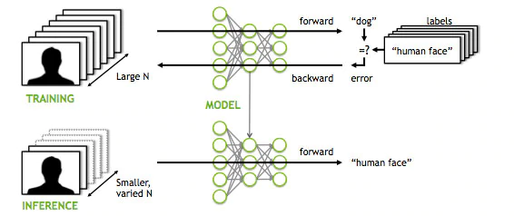
STONNE Roadmap
1. Extension of the functionality of STONNE:
Simulation of non-computation-intensive layers (e.g., Max/Avg Pooling)
Link with other DL frameworks (e.g., TensorFlow Lite)
Simulation of training processes

Slide 5


STONNE Roadmap
2. Integration of STONNE with other tools:
Connection of STONNE with the TVM¹ open-source machine learning compiler framework
Integration of STONNE in gem5² to allow for detailed study of CPU-Accelerator interaction
¹ https://tvm.apache.org/
² https://www.gem5.org/
Notes:
* Search space of DNN mapping is a high dimensional optimization problem
mRNA: DNN Mapping Space Exploration tool for MAERI
Deep learning domain-specific and MAERI-specific heuristics to reduce the searching space.
Maximize the energy efficiency and/or minimize runtime
* SST is a fully modular design that enables extensive exploration of an individual system parameter without the need for intrusive changes to the simulator. The second is a parallel simulation environment based on MPI. This provides a high level of performance and the ability to look at large systems.. STONNE has been integrated as a component called sstStonne in SST. sstStonne connects to memHierarchy component to faithfully model the memory hierarchy of the accelerato

Slide 6
OMEGA Roadmap
Current version of OMEGA publicly available at:
https://github.com/stonne-simulator/omega
Ongoing and future development of the OMEGA framework also envisages two main directions:
Extension of the functionality of OMEGA
Integration of OMEGA with other tools

Slide 7
OMEGA Roadmap
1. Extension of the functionality of OMEGA:
Generalize the analysis for dataflows for multiphase computation like DL recommendation models or Attention models.
Build a mapping optimizer on top of this work:
The taxonomy of the proposed dataflows will help formalize the design-space for mapping search.
The OMEGA framework can be used as a cost model that the mapping search tool can employ.
Notes:
* Search space of DNN mapping is a high dimensional optimization problem
mRNA: DNN Mapping Space Exploration tool for MAERI
Deep learning domain-specific and MAERI-specific heuristics to reduce the searching space.
Maximize the energy efficiency and/or minimize runtime
* SST is a fully modular design that enables extensive exploration of an individual system parameter without the need for intrusive changes to the simulator. The second is a parallel simulation environment based on MPI. This provides a high level of performance and the ability to look at large systems.. STONNE has been integrated as a component called sstStonne in SST. sstStonne connects to memHierarchy component to faithfully model the memory hierarchy of the accelerato

Slide 8
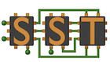
OMEGA Roadmap
2. Integration of OMEGA with other tools:
It is possible to use the OMEGA frameworks with other simulation tools or analytical models in addition to STONNE.
The parameters and timestamps from these tools can be fed into the inter-phase cost model.
With STONNE’s integration with SST, it would also be possible to instantiate STONNE two times and write a configuration file for each inter-phase dataflow strategy to execute GNNs and study the execution of GNNs with traditional memory hierarchy.
Moreover, with recent support for Gustavson's and Outer-product dataflows in SST-STONNE, exploration of such dataflows for emerging GNNs is another direction.
Notes:
* Search space of DNN mapping is a high dimensional optimization problem
mRNA: DNN Mapping Space Exploration tool for MAERI
Deep learning domain-specific and MAERI-specific heuristics to reduce the searching space.
Maximize the energy efficiency and/or minimize runtime
* SST is a fully modular design that enables extensive exploration of an individual system parameter without the need for intrusive changes to the simulator. The second is a parallel simulation environment based on MPI. This provides a high level of performance and the ability to look at large systems.. STONNE has been integrated as a component called sstStonne in SST. sstStonne connects to memHierarchy component to faithfully model the memory hierarchy of the accelerato

Slide 9
Concluding remarks
Some takeaways:
Use of current analytical models can lead to significant inaccuracies in performance and energy consumption estimations when it comes to more complex DDN accelerator microarchitectures
Having to build the RTL model of a DNN accelerator does not allow for rapid quantification of the efficacy of architectural enhancements during the early stages of a design
Need for cycle-level DNN architectural simulation
STONNE is able to model rigid and flexible accelerators, and data-dependent optimizations, all performing the actual computation of complete DNN models
SST-STONNE provides a detailed model for the memory hierarchy and support for key tensor operations used in the DL domain (Convolution, GEMM, SpMSpM, and SpMM)
Also, STONNE can be a building block for modeling other DL accelerators:
The OMEGA framework builds on top of STONNE to enable modeling of the cost of the pipelined GNN dataflows
Notes:
* As the complexity of the microarchitecture of DNN accelerators grows, the analytical models are not able to capture many important subtleties that simulation at cycle level does.

Slide 10
Concluding remarks
Willing to contribute?
For bug notices please create a new issue on the corresponding Git repository (main simulator, SST plugin or OMEGA)
https://github.com/stonne-simulator
For additional extensions to be included in the public release or suggestions for enhancements, please contact:
stonnesimulator@gmail.com

Slide 11
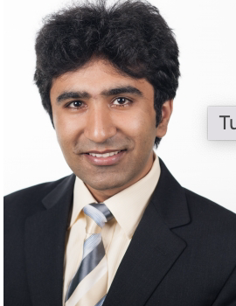
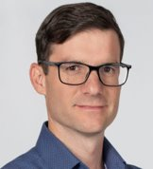
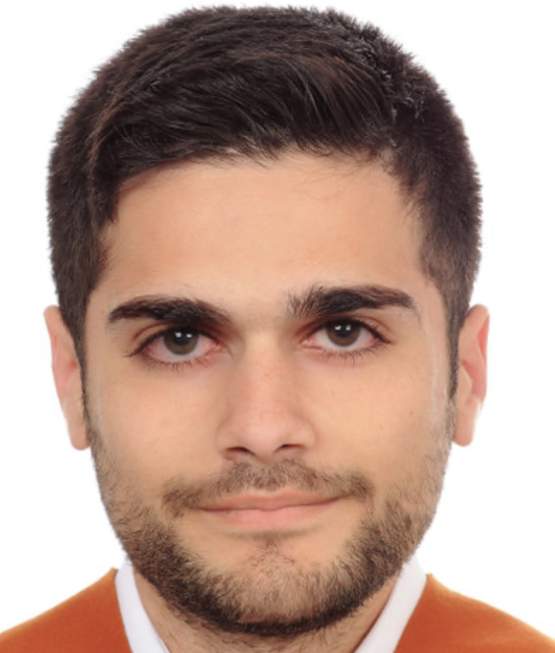

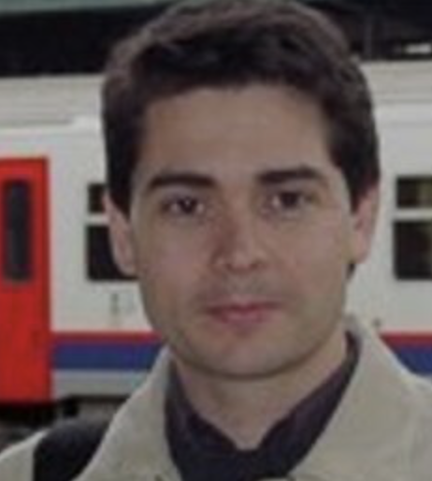
Thank you for your interest in the STONNE ecosystem!
Tushar Krishna José L. Abellán Francisco Muñoz-Martínez Raveesh Garg Manuel E. Acacio
Notes:
New features that we are currently working on and/or plan to support in the short-term

Slide 12



Acknowledgements
Co-Design Center for Artificial Intelligence-Focused Architectures and Algorithms Funded By

Slide 13
STONNE: A Simulation Tool for Neural Network Engines
Francisco Muñoz-Martínez, Raveesh Garg,
José L. Abellán, Manuel E. Acacio, Tushar Krishna
Notes:
New features that we are currently working on and/or plan to support in the short-term

